Slide 1
Example:
Birth probability

Slide 2
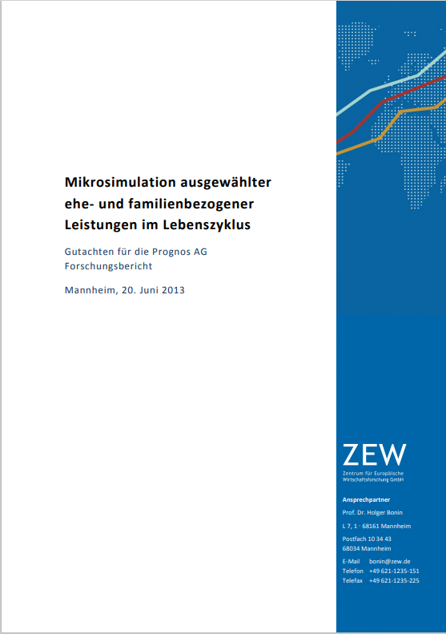
Bonin, Holger, Friedhelm Pfeiffer, Karsten Reuß, und Holger Stichnoth. 2013. Mikrosimulation ausgewählter ehe- und familienbezogener Leistungen im Lebenszyklus. Mannheim: Gutachten im Auftrag der Prognos AG.

Slide 3






t

Slide 4






Birth probability

Slide 5
Birth probability
#(existing children)

Slide 6
Birth probability
#(existing children)
Marital status

Slide 7
Birth probability
#(existing children)
Marital status
Age

Slide 8
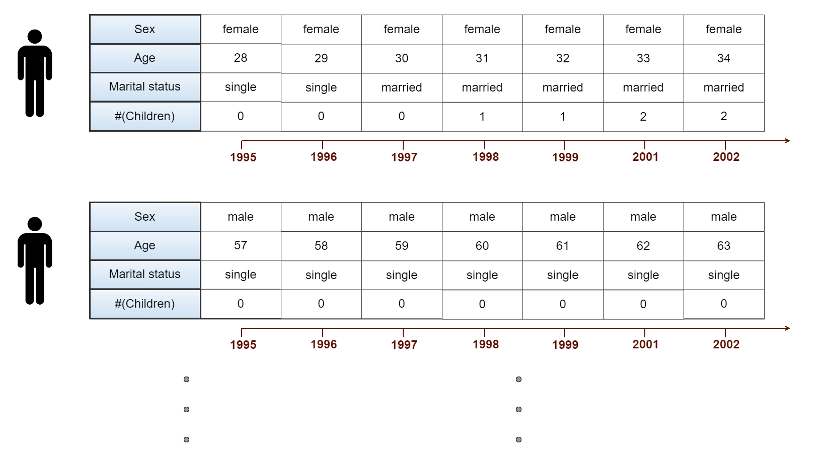


German Socio‐Economic Panel Data

Slide 9
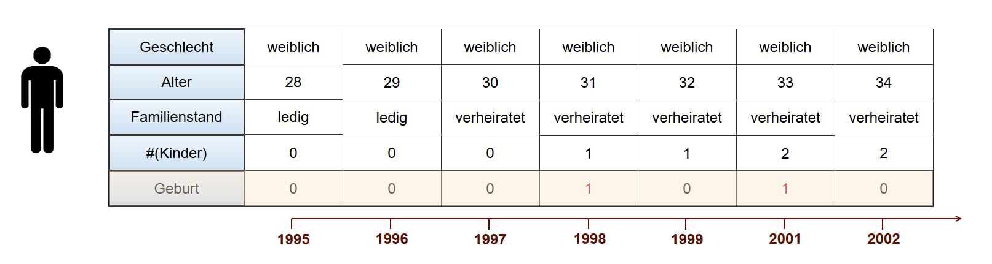
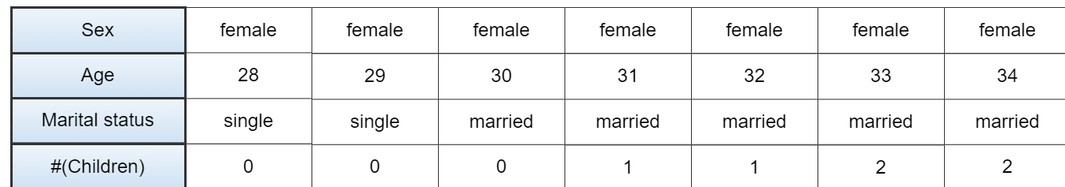
German Socio‐Economic Panel Data

Slide 10
German Socio‐Economic Panel Data
Probit-model:
X
y

Slide 11
German Socio‐Economic Panel Data
Probit-model:
X
y
y
1
0

Slide 12
German Socio‐Economic Panel Data
Probit-model:
X
y
y = Birth probability
1
0

Slide 13
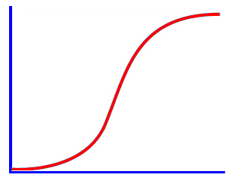
Birth probability

Slide 14
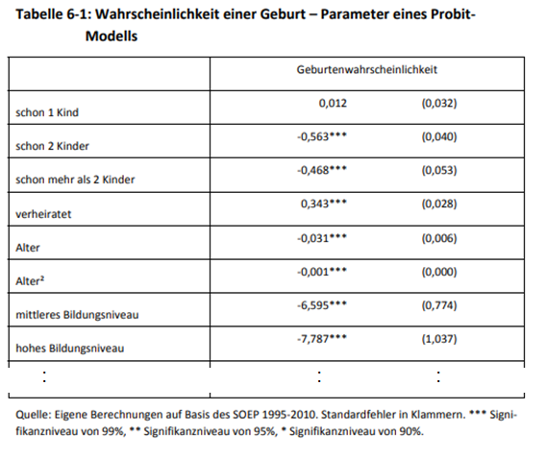

Slide 15
weight_one_child =

Slide 16
weight_one_child =
weight_two_children =

Slide 17
weight_one_child =
weight_two_children =
weight_more_than_two_children =
weight_married =
weight_age =
weight_age_squared =

Slide 18
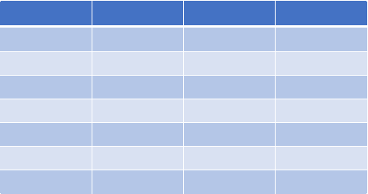

Traditional approach:
weight_one_child
weight_two_children
weight_more_than_two_children
weight_married
weight_age
weight_age_squared

Slide 19
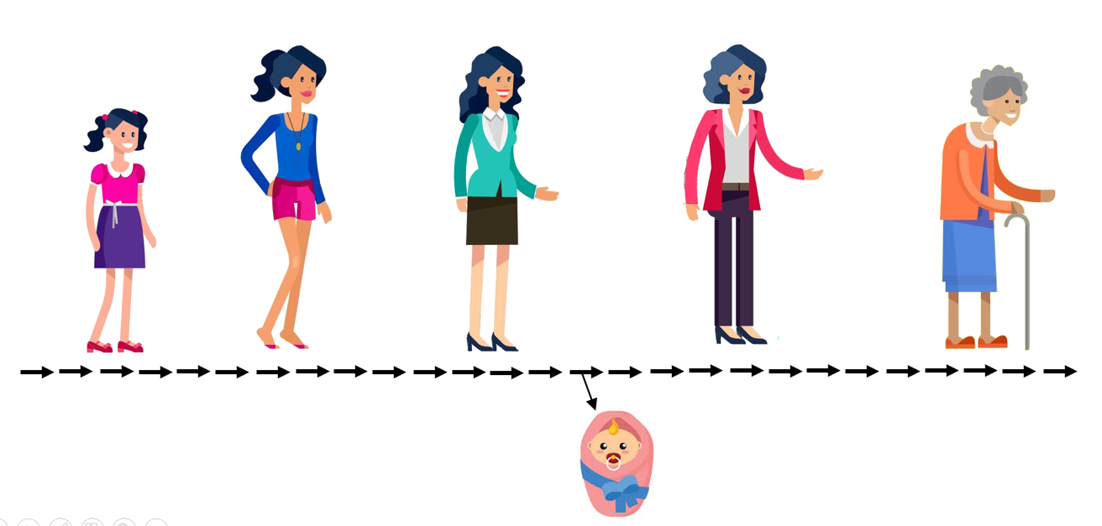
Traditional approach:
weight_one_child
weight_two_children
weight_more_than_two_children
weight_married
weight_age
weight_age_squared
Tree of Knowledge‘s approach:
weight_one_child
weight_two_children
weight_more_than_two_children
weight_married
weight_age
weight_age_squared

Slide 20
National Longitudinal Survey of Youth (NLS)
Fertility rate
by age of mother

Slide 21
National Longitudinal Survey of Youth (NLS)
Fertility rate
by age of mother

Slide 22
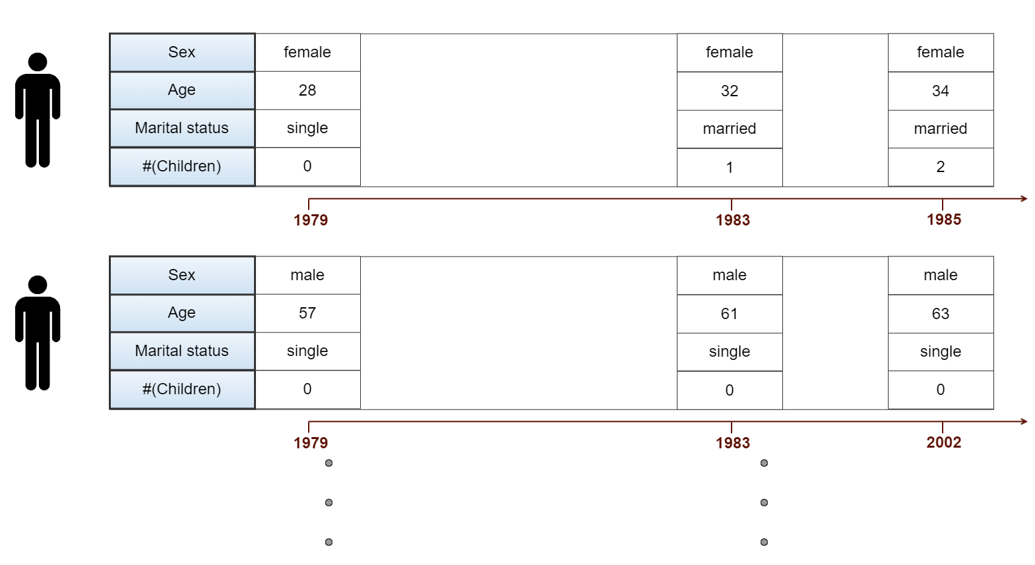
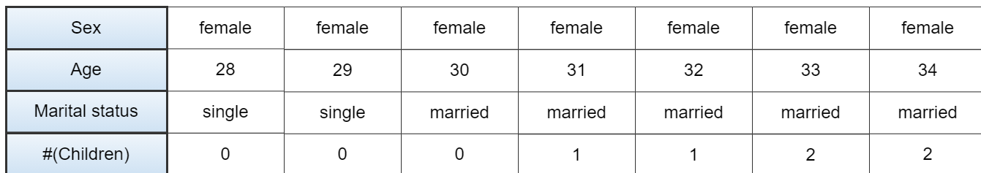
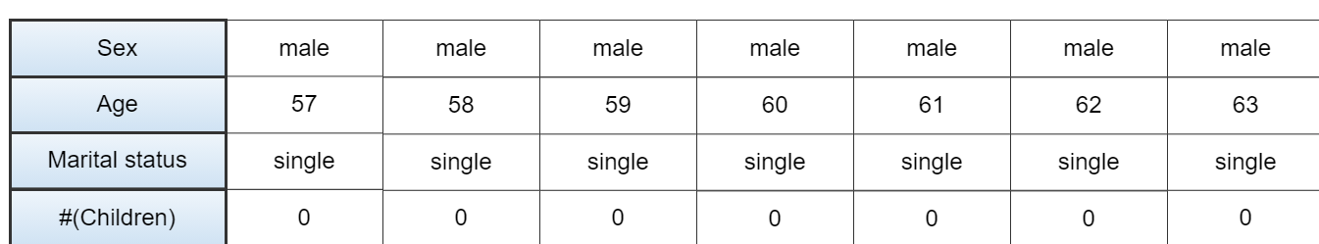

First dataset:
National Longitudinal Survey of Youth (NLS)

Slide 23
First dataset:
National Longitudinal Survey of Youth (NLS)

Slide 24
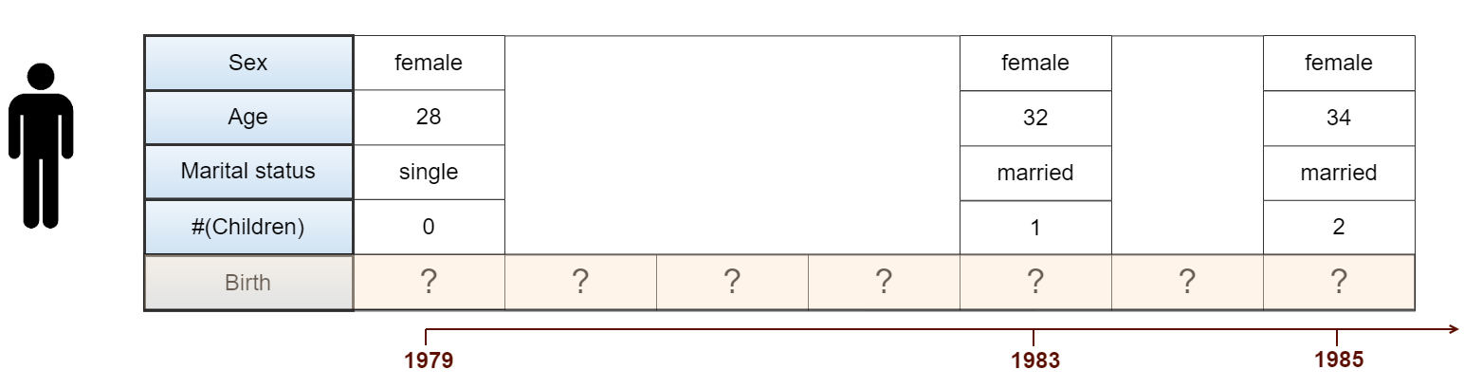
First dataset:
National Longitudinal Survey of Youth (NLS)

Slide 25
National Longitudinal Survey of Youth (NLS)
Fertility rate
by age of mother

Slide 26
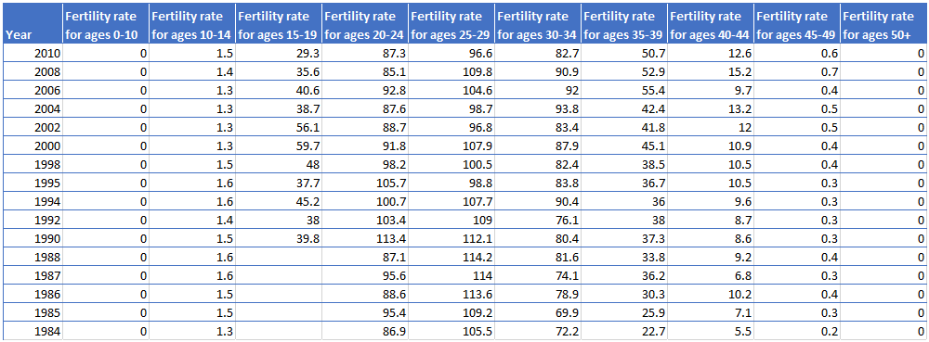
First dataset:
National Longitudinal Survey of Youth (NLS)

Slide 27
National Longitudinal Survey of Youth (NLS)
Fertility rate
by age of mother

Slide 28


National Longitudinal Survey of Youth (NLS)
Fertility rate
by age of mother

Slide 29

National Longitudinal Survey of Youth (NLS)
Fertility rate
by age of mother

Slide 30
First dataset: NLSY
1.1. Log in
1.2. Upload data
1.3. Create simulation
1.4. Simulation results

Slide 31
First dataset: NLSY
1.1. Log in
1.2. Upload data
1.3. Create simulation
1.4. Simulation results
2. Second dataset: Fertility rates
2.1. Create simulation
2.2 Simulation results

Slide 32
First dataset: NLSY
1.1. Log in
1.2. Upload data
1.3. Create simulation
1.4. Simulation results
2. Second dataset: Fertility rates
2.1. Create simulation
2.2 Simulation results
3. Joint parameter learning

Slide 33
First dataset: NLSY
1.1. Log in
1.2. Upload data
1.3. Create simulation
1.4. Simulation results
2. Second dataset: Fertility rates
2.1. Create simulation
2.2 Simulation results
3. Joint parameter learning
4. Evaluate different agent behaviours

Slide 34

First dataset: NLSY
1.1. Log in
1.2. Upload data
1.3. Create simulation
1.4. Simulation results
2. Second dataset: Fertility rates
2.1. Create simulation
2.2 Simulation results
3. Accumulation of knowledge
4. Evaluate agent behaviours

Slide 35
1.1. Log in

Slide 36
1.2. Upload data

Slide 37
Data
Agent behaviour
Facts
etc.

Slide 38
1.3. Create simulation

Slide 39
weight_one_child
weight_two_children
weight_more_than_two_children
weight_married
weight_age
weight_age_squared

Slide 40
weight_one_child
weight_two_children
weight_more_than_two_children
weight_married
weight_age
weight_age_squared

Slide 41
weight_one_child
weight_two_children
weight_more_than_two_children
weight_married
weight_age
weight_age_squared

Slide 42
?
National Longitudinal Survey of Youth

Slide 43




t
National Longitudinal Survey of Youth
t

Slide 44
t
National Longitudinal Survey of Youth
t

Slide 45
t
National Longitudinal Survey of Youth
t

Slide 46
t
National Longitudinal Survey of Youth
t

Slide 47
1.4. Simulation results

Slide 48
Second dataset :
Fertility rate by age of mother

Slide 49
Second dataset:
Fertility rate by age of mother

Slide 50
2.1. Create Simulation

Slide 51
Second dataset:
The system
1979
2016

Slide 52
Second dataset:
The system
1979
2016

Slide 53
2.2. Simulation results

Slide 54
Accumulation of knowledge

Slide 55
Evaluate
agent behaviours

